Slide 1
5-3 Serial Peripheral Interface SPI
Doing serial Fast

Slide 2
Day 5-3
Assignment:
Today’s Topics:
HW 06, Due Tuesday
Projects
SPI
LCD

Slide 3

SPI: Intro
Serial Peripheral Interface (SPI) is an interface bus commonly used to send data between microcontrollers and small peripherals
(shift registers, sensors, and SD cards)
It uses separate clock and data lines, along with a select line to choose the device you wish to talk to.
From: https://learn.sparkfun.com/tutorials/serial-peripheral-interface-spi

Slide 4
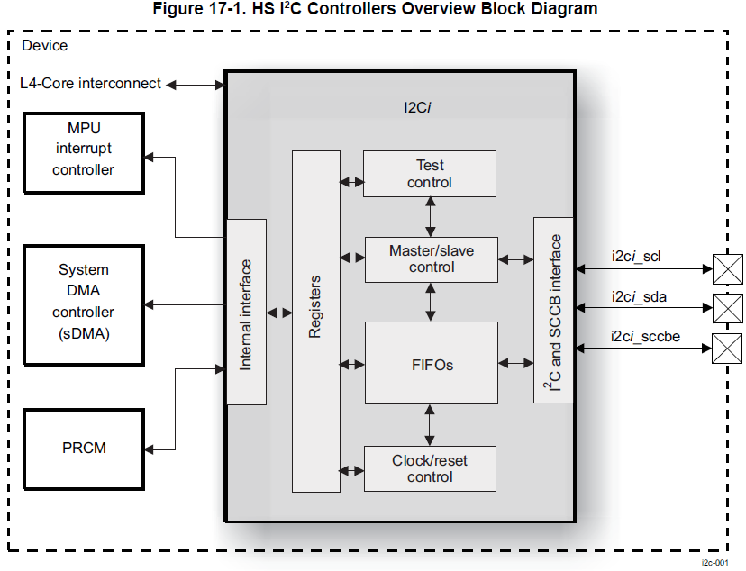
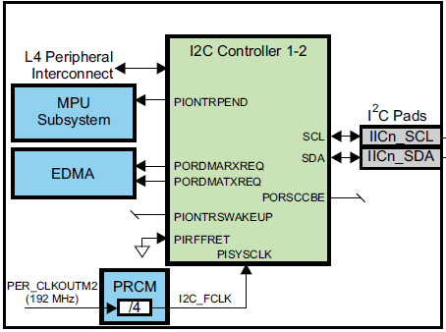
I²C - FlashBack
“two-wire interface” standard
Used to attach low-speed peripherals to embedded systems

Slide 5
SPI: Intro
Serial Peripheral Interface (SPI) is an interface bus commonly used to send data between microcontrollers and small peripherals
(shift registers, sensors, and SD cards)
It uses separate clock and data lines, along with a select line to choose the device you wish to talk to.
From: https://learn.sparkfun.com/tutorials/serial-peripheral-interface-spi

Slide 6
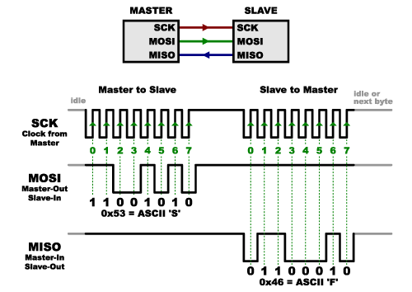
SPI - Clock
One side generates the clock
Called the master (only one)
Other side is called the slave
There are two data lines
MOSI – Master Out / Slave In
MISO – Master In / Slave Out

Slide 7
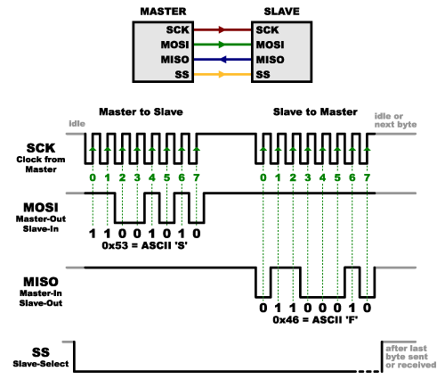
Slave Select
Tells slave it should wake up.
Used if multiple slaves
SS or CS (chip celect)

Slide 8
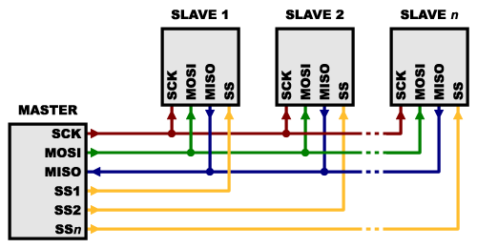
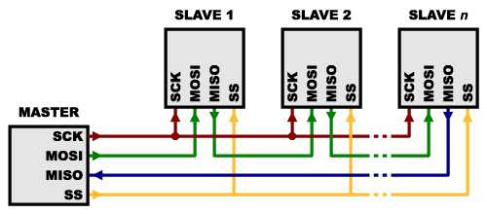
Multiple Slaves
Use multiple Chip Selects
SP1.1 and SP1.2 on Blue
Daisy-chain
Used with addressable LEDs

Slide 9
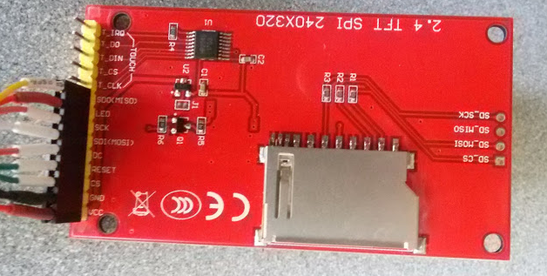
LCD Display
MISO
LED
SCK
MOSI
DC
Reset
CS
GND
VCC

Slide 10
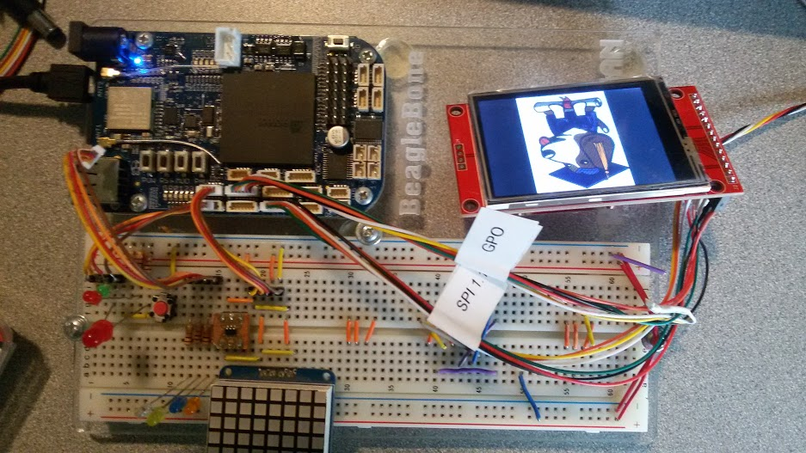
Wiring LCD

Slide 11
LCD Software
bone$ cd exercises/displays/ili9341
bone$ ./on.sh
bone$ ./off.sh
bone$ ./reset.sh

Slide 12
On.sh
sudo bash << EOF
UNEXPORT= /sys/class/gpio/unexport
echo 113 > $UNEXPORT # RESET - GP0_6
echo 116 > $UNEXPORT # D/C - GP0_5
OCP=/sys/devices/platform/ocp
echo gpio > $OCP/ocp:P9_28_pinmux/state # RESET- P9_28 - GP0_6
echo gpio > $OCP/ocp:D13_pinmux/state # D/C - D13 - GP0_5

Slide 13
On.sh - 2
sudo bash << EOF
…
echo spi > $OCP/ocp:P9_31_pinmux/state # SCLK - S1.1_5
echo spi > $OCP/ocp:P9_29_pinmux/state # MISO - S1.1_4
echo spi > $OCP/ocp:P9_30_pinmux/state # MOSI - S1.1_3

Slide 14
On.sh - 3
sudo bash << EOF
…
echo 29 > $UNEXPORT # CS - H18
echo spi > $OCP/ocp:H18_pinmux/state # CS - S1.1_6

Slide 15
On.sh - 4
sudo bash << EOF
…
sleep 1
# Insert the framebuffer modules
modprobe fbtft_device name=adafruit28 busnum=1 rotate=90 \
gpios=reset:113,dc:116 cs=0
EOF

Slide 16
modinfo
bone$ modinfo fbtft_device
filename: /lib/modules/4.4.84-ti-r120/kernel/drivers/staging/fbtft/fbtft_device.ko
license: GPL
author: Noralf Tronnes
description: Add a FBTFT device.
depends: fbtft
staging: Y
intree: Y
vermagic: 4.4.84-ti-r120 SMP mod_unload modversions ARMv7 p2v8

Slide 17
modinfo
parm: name:Devicename (required). name=list => list all supported devices. (charp)
parm: rotate:Angle to rotate display counter clockwise: 0, 90, 180, 270 (uint)
parm: busnum:SPI bus number (default=0) (uint)
parm: cs:SPI chip select (default=0) (uint)
parm: speed:SPI speed (override device default) (uint)
parm: mode:SPI mode (override device default) (int)
parm: gpios:List of gpios. Comma separated with the form: reset:23,dc:24 (when overriding the default, all gpios must be specified) (charp)
parm: fps:Frames per second (override driver default) (uint)
parm: gamma:String representation of Gamma Curve(s). Driver specific. (charp)

Slide 18
modinfo
parm: txbuflen:txbuflen (override driver default) (int)
parm: bgr:BGR bit (supported by some drivers). (int)
parm: startbyte:Sets the Start byte used by some SPI displays. (uint)
parm: custom:Add a custom display device. Use speed= argument to make it a SPI device, else platform_device (bool)
parm: width:Display width, used with the custom argument (uint)
parm: height:Display height, used with the custom argument (uint)
parm: buswidth:Display bus width, used with the custom argument (uint)
parm: init:Init sequence, used with the custom argument (array of int)
parm: debug:level: 0-7 (the remaining 29 bits is for advanced usage) (ulong)
parm: verbose:0 silent, >0 show gpios, >1 show devices, >2 show devices before (default=3) (uint)

Slide 19
On.sh - 4
sudo bash << EOF
…
sleep 1
# Insert the framebuffer modules
modprobe fbtft_device name=adafruit28 busnum=1 rotate=90 \
gpios=reset:113,dc:116 cs=0
EOF

Slide 20
FrameBuffers
Once the modprobe is run
/dev/fb0 appears
You can read and write to it.
bone$ cat /dev/fb0 > /tmp/backup
bone$ cat /tmp/backup > /dev/fb0

Slide 21
Programs use it
Display an image
bone$ fbi -noverbose -T 1 -a boris.png
Play a movie
bone$ mplayer RedsNightmare.mpg
pygame

Slide 22
mmap
You can open it with mmap

Slide 23
Framebuffer.c
// Open the file for reading and writing
fbfd = open("/dev/fb0", O_RDWR);
if (fbfd == -1) {
perror("Error: cannot open framebuffer device");
// Open the file for reading and writing fbfd = open("/dev/fb0", O_RDWR); if (fbfd == -1) { perror("Error: cannot open framebuffer device"); exit(1); } printf("The framebuffer device was opened successfully.\n"); exit(1);
}
printf("The framebuffer device was opened successfully.\n");

Slide 24
Framebuffer.c - 2
// Figure out the size of the screen in bytes
screensize = vinfo.xres * vinfo.yres * vinfo.bits_per_pixel / 8;
// Map the device to memory
fbp = (char *) mmap(0, screensize, PROT_READ | PROT_WRITE, MAP_SHARED, fbfd, 0);
if ((int)fbp == -1) {
perror("Error: failed to map framebuffer device to memory");
exit(4);
}
printf("The framebuffer device was mapped to memory successfully.\n");

Slide 25
Framebuffer.c - 3
// Figure out where in memory to put the pixel
location = (x+vinfo.xoffset) * (vinfo.bits_per_pixel/8) +
(y+vinfo.yoffset) * finfo.line_length;
int r = 0; // 5 bits
int g = 0; // 6 bits
int b = 31; // 5 bits
unsigned short int t = r<<11 | g << 5 | b;
*((unsigned short int*)(fbp + location)) = t;

Slide 26
Screen Size
// Get fixed screen information
if (ioctl(fbfd, FBIOGET_FSCREENINFO, &finfo) == -1) {
perror("Error reading fixed information");
exit(2);
}
// Get variable screen information
if (ioctl(fbfd, FBIOGET_VSCREENINFO, &vinfo) == -1) {
perror("Error reading variable information");
exit(3);
}

Slide 27
Reset.sh
sudo bash << EOF
# Save contents of framebuffer
cat /dev/fb0 > /tmp/fb0
# Disable the framebuffer
rmmod fbtft_device
sleep 1

Slide 28
Reset.sh
sudo bash << EOF
# Get access to the RESET pin
echo 49 > /sys/class/gpio/export # RESET - V14 - GP0_PIN4
sleep 1
# Toggle it
echo out > /sys/class/gpio/gpio49/direction
echo 0 > /sys/class/gpio/gpio49/value
echo 1 > /sys/class/gpio/gpio49/value
# Remove access so the framebuffer can use it
echo 49 > /sys/class/gpio/unexport # RESET - GP0_PIN4

Slide 29
Reset.sh
# Fire up the framebuffer
echo Firing up framebuffer
sleep 1
modprobe fbtft_device name=adafruit28 busnum=1
rotate=270 gpios=reset:113,dc:116 cs=0
# Restore the image
cat /tmp/fb0 > /dev/fb0
EOF

